Slide 1
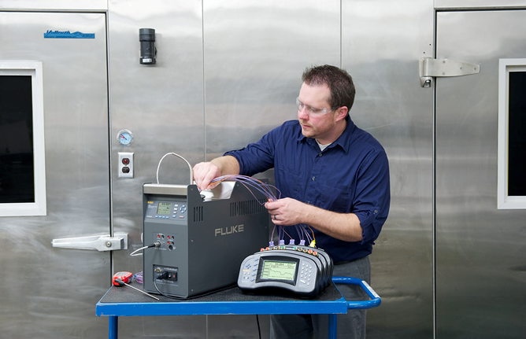
9190A Ultra-Cool Field Metrology Well

Slide 2

9190A Ultra-Cool Field Metrology Well
Product positioning
Typical applications
Key features & benefits
Competitive comparison
Product overview
Workload
Product features
Euramet/cg-13 overview
Summary specs
Standard equipment, options & demo kits
Sales & marketing materials

Slide 3
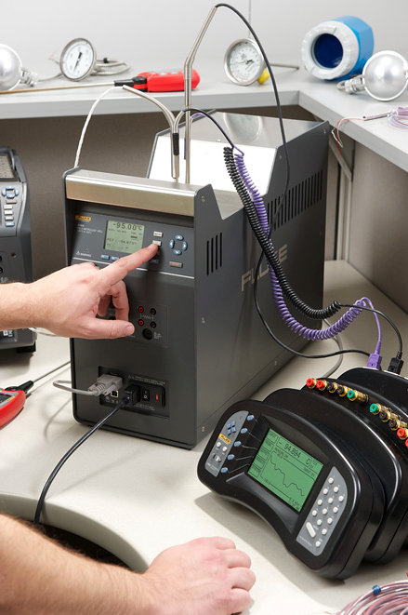

9190A Product Positioning
The most stable cold temperature
dry-block calibrator you can buy
Wide temperature range: –95 ºC to 140 ºC
Brackets the coldest and highest temperatures required for most pharmaceutical, biomedical and food processing applications
Best-in-class stability: ±0.015 ºC full range
2x better than the competition
Ideal for applications that demand strict quality control and regulatory process compliance
Great for cleanroom environments
Faster heating & cooling rates than a bath
Easier to transport
No bath fluids that can spill and give off vapors
When temperatures stay stable during calibration, you can be confident results are accurate

Slide 4
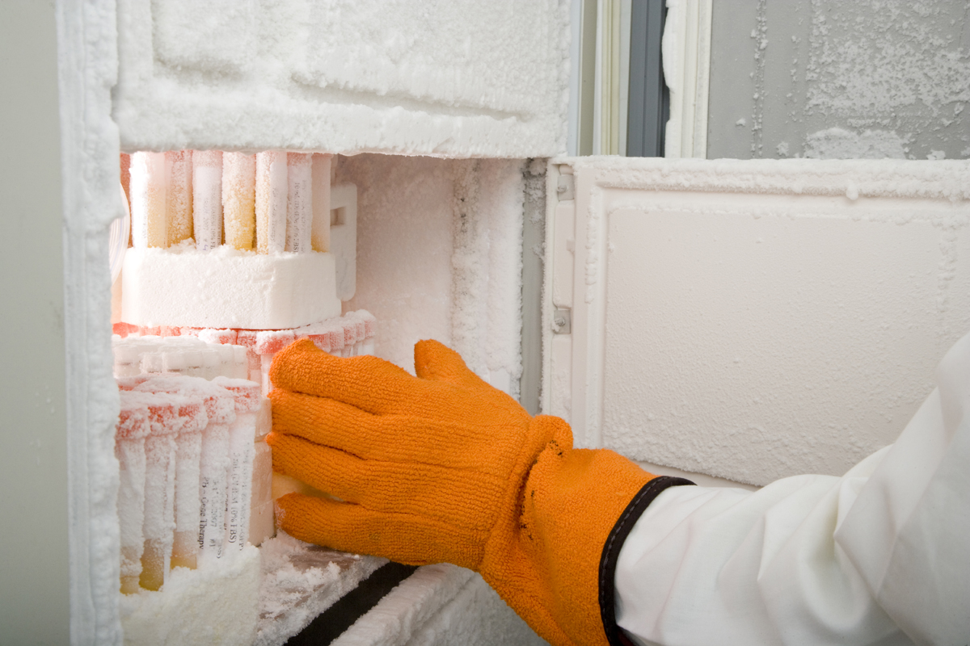
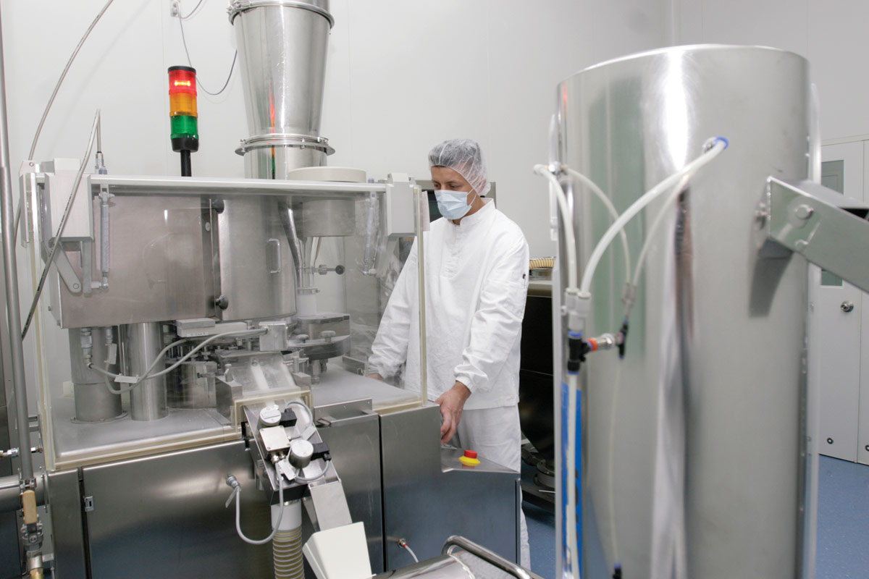
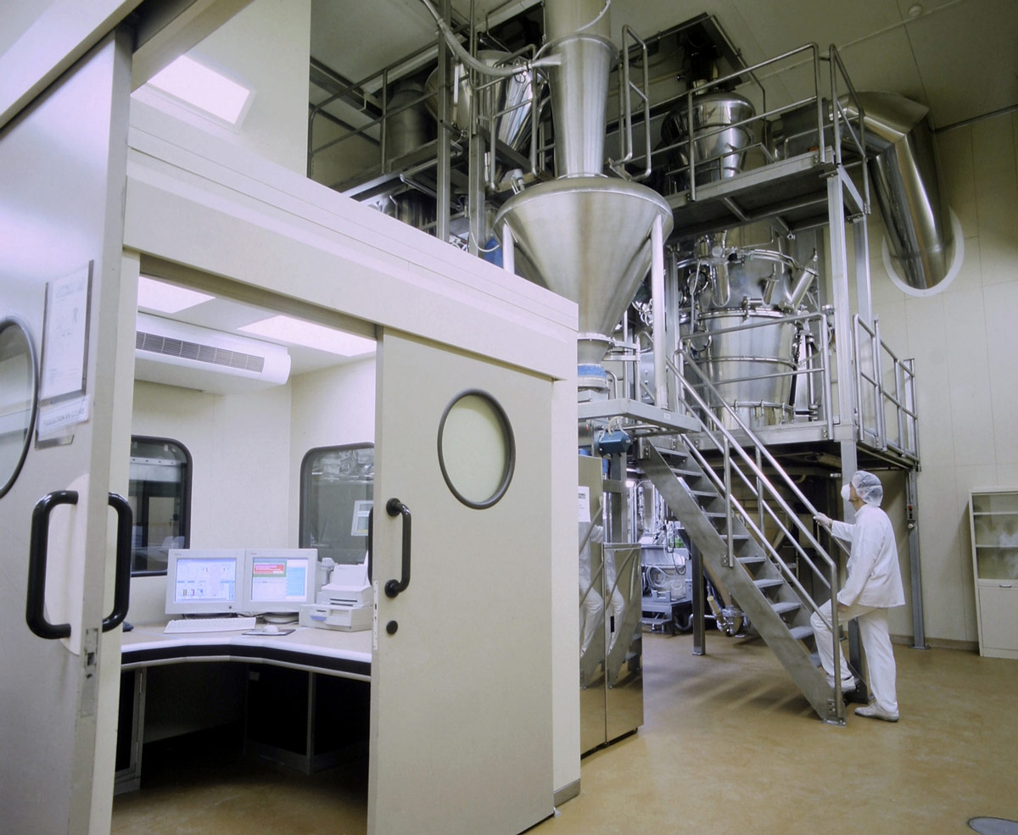
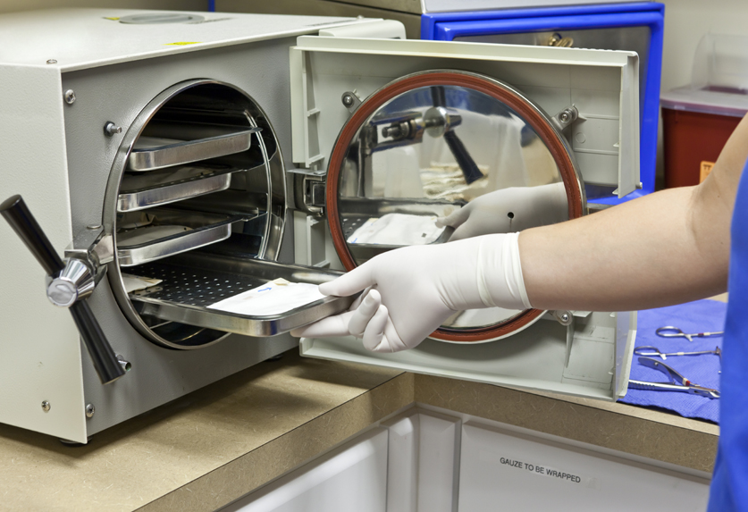
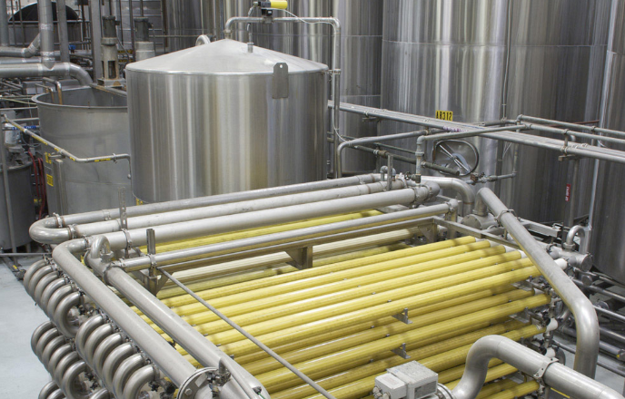
9190A Typical Applications
Industry | Applications
Pharmaceutical | Laboratory refrigerators, Freezers, Cleanrooms, Steam-in-place (SIP), Freeze-drying
Biomedical | Medical freezers, Sample and culture storage, Blood banks, Sterilizers (autoclaves), Quality monitoring
Food Processing | Process control sensors, Transmitters, Freeze-drying
Test & Measurement | 3rd party labs (on-site calibration)
Energy | Process control sensors
Notes:
1) It should be understood that the applications mentioned infer calibration of a temperature sensor used in the application or device

Slide 5
9190A Key Features & Benefits
Feature | Benefit
Best stability and uniformity | The 9190A stability is 2Xs better than competitor cold-temperature drywells. When using an external reference thermometer, stability & uniformity are the largest contributors to overall measurement uncertainty. A more stable temperature source means a more accurate calibration, which can equate to major savings (or cost depending on the situation).
Speed to temperature | The 9190A provides the fastest speed to temperature. While competitors use the same free piston Stirling cooler (FPSC), the 9190A requires less time to reach temperature and stabilize. This is due to Fluke Calibration refrigeration expertise and proprietary controller technology.
Reference temperature control | This feature reduces uncertainties due to axial gradients when calibrating short sensors.
Process inputs | The 9190A with “process” option provides a complete calibration with a single tool. There’s no need to carry extra gear when performing on-site calibrations.
Ergonomics and industrial design | Built-in handles make the 9190A easier and safer to carry than a bail-style handle.

Slide 6
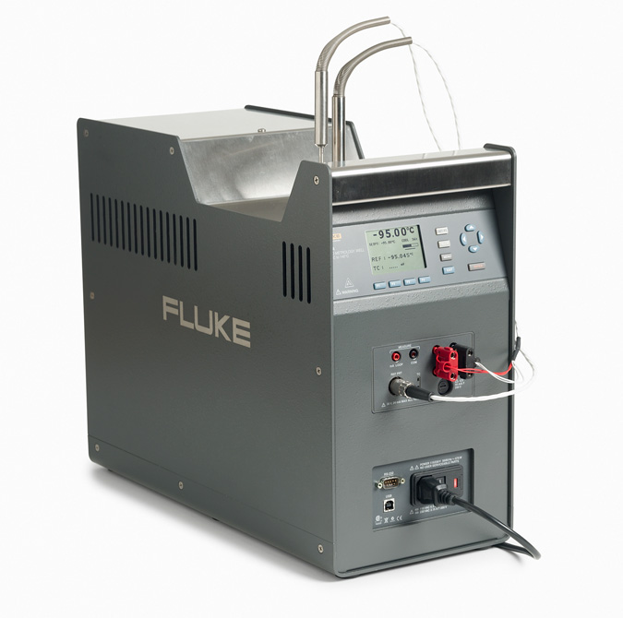
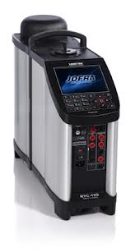
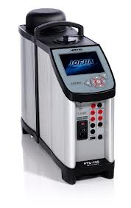
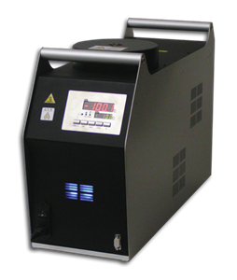
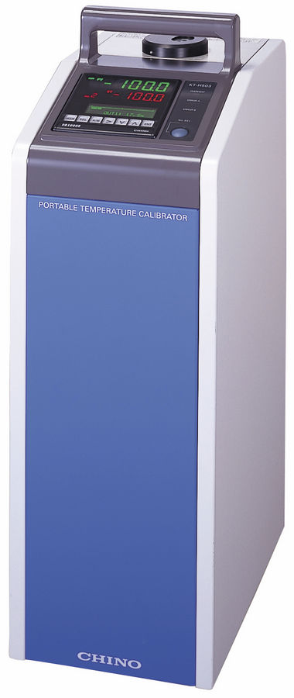
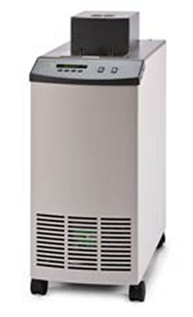
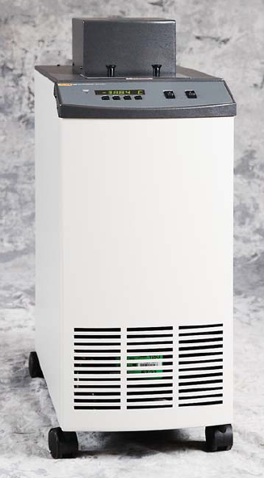
9190A Competitive Comparison
Competitive Comparison
 |  | Temperature Range (°C) | Display Accuracy | Accuracy w/Ext. Reference | Cool Time, Ambient to Min (minutes) | Stability at Min Temp | Axial Uniformity | Total Immersion Depth (mm) | True Temperature Feature (3) | Dynamic Load Compensation
Fluke 9190A-P |  | -95 to 140 | ± 0.15 °C | ± 0.05 °C | 90 (1.3 °C/min) | ± 0.015 °C | ± 0.05 °C | 160 | Yes | No
Fluke 9190A |  | -95 to 140 | ± 0.15 °C | n/a | 90 (1.3 °C/min) | ± 0.015 °C | ± 0.05 °C | 160 | No | No
Jofra RTC-159 |  | -100 to 155 | ± 0.3 °C | ± 0.06 °C (1) | 135 (1 °C/min) | ± 0.03 °C | ± 0.01 °C (2) | 190 | Yes | Yes (4)
Jofra PTC-125 |  | -90 to 125 | ± 0.3 °C | ± 0.07 °C (1) | 115 (1 °C/min) | ± 0.03 °C | ± 0.05 °C (2) | 190 | Yes | No
Isotech Isis |  | -100 to 40 | ± 0.3 °C | n/a | 90 (1.4 °C/min) | ± 0.02 °C | ± 0.2 °C | 160 | No | No
Chino KT-H503 |  | -100 to 50 | - | n/a | 37 (3.4 °C/min) | ± 0.03 °C | ± 0.05 °C | 205 | No | No
Fluke 7380 |  | -80 to 100 | ± 0.5 °C | ± 0.015 | 130 (0.8 °C/min) | ± 0.006 °C | ± 0.007 °C | 457 | No | Yes (5)
Fluke 7381 |  | -80 to 110 | ± 0.5 °C | ± 0.015 | 210 (0.5 °C/min) | ± 0.006 °C | ± 0.008 °C | 178 | No | Yes (5)
Notes:
(1) External reference sensor is a priced option.
(2) No specification. Based on graphic in datasheet. Assumes Dynamic Load Compensation (a priced option) is enabled.
(3) The "True Temperature" features allows the block temperature control to be passed from the block sensor to the reference thermometer.
(4) The Dynamic Load Compensation feature is a priced option that improves vertical gradients when the drywell is loaded with multiple UUTs.
(5) Fluid medium allows for maximum loading compared to a dry-well.

Slide 7
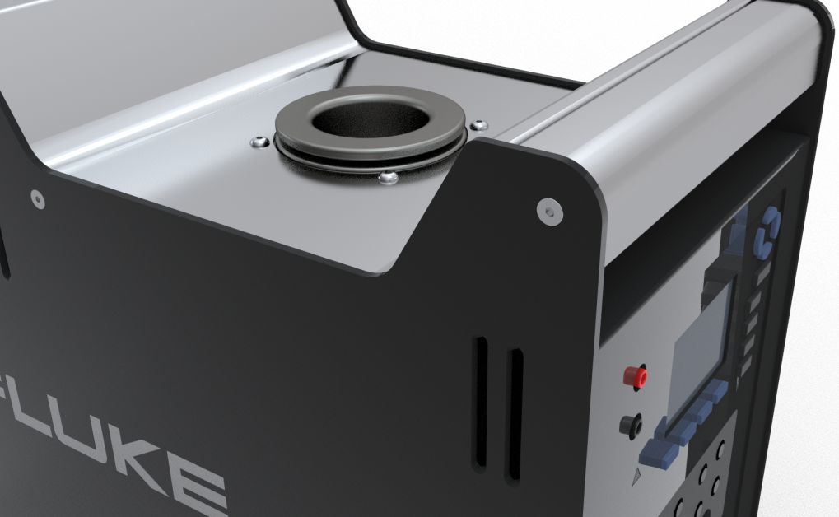
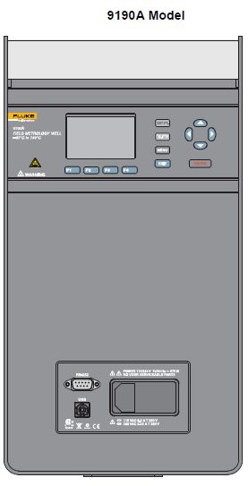
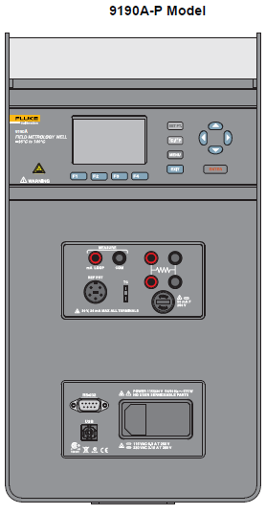
9190A Product Overview
–95 ºC to 140 ºC Field Metrology Well
Fast cooling time: reaches –95 ºC in 90 minutes
Temperature stability of ±0.015 ºC (2x’s better than competition)
Two models: 9190A, 9190A-P
9190A-P “process” option includes: reference thermometer input, RTD input, TC input, 4-20 mA measure, 24 Vdc loop power supply
UI translations: C,J,K,F,G,S,P,R
Weight: 16 kg (35 lbs.)
Best measurement practices: Conforms to EURAMET cg-13

Slide 8
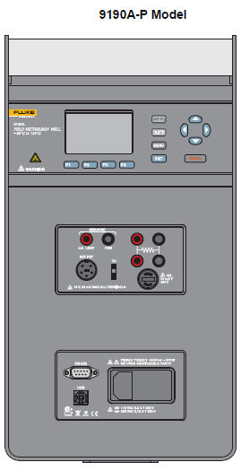
9190A Product Overview
Optional Process Inputs
4-20mA Connectors
Power a 4-20 mA transmitter from the drywell. Supplies 24 Vdc loop power.
4-Wire PRT/RTD Input
Reads a 4-wire, 3-wire, or 2-wire PRT/RTD
Accuracy ±0.02 ºC.
4-20 mA Circuit Fuses
Thermocouple Input
Accepts common thermocouples with mini-jack termination
Types: J,K,T,E,R,S,M,L,U,N,C
Reference Thermometer Input
Automatically reads Fluke Calibration PRTs terminated with a “smart” connector
Accuracy ±0.01 ºC at –95 ºC
Notes:
All inputs accessible from the front panel [i.e. PC interface, process inputs, power entry module (PEM)]
Note, the 9190A does not included a thermostatic switch test function like the 914X.

Slide 9
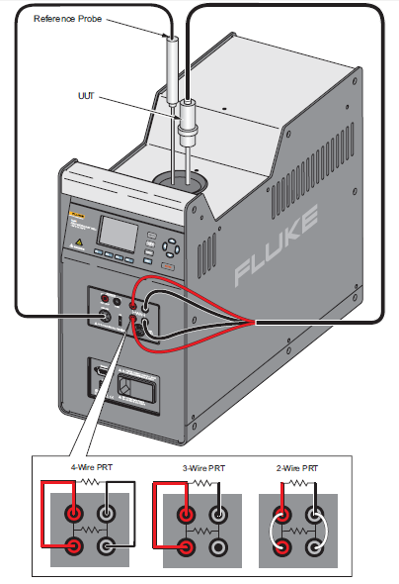
9190A Product Overview
Optional Process Inputs
Example:
Reference thermometer and UUT (4-wire RTD) connection
Reads reference thermometer and one UUT simultaneously (RTD or TC)
Accommodates 2-, 3- and 4-wire connection
Displays both reference thermometer temperature and UUT simultaneously

Slide 10
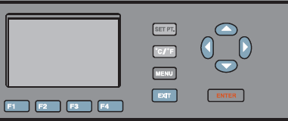
9190A Product Overview
Toggle between ºC / ºF
Dedicated set point key
Standard PC Interface
RS-232 (9-pin)
USB serial connector
Power Entry Module
Mains power cord receptacle
Power switch
System fuses
Notes:
All inputs accessible from the front panel [i.e. PC interface, process inputs, power entry module (PEM)]

Slide 11
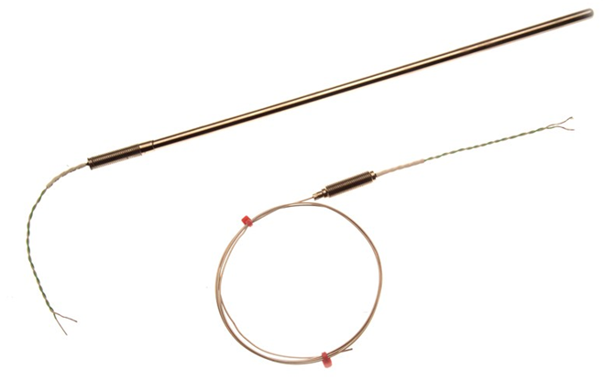
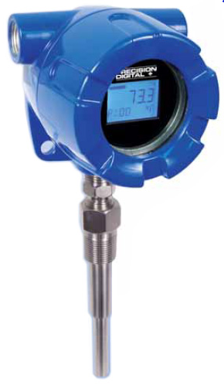
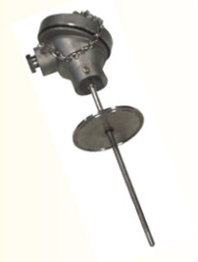
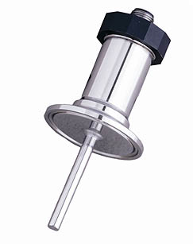
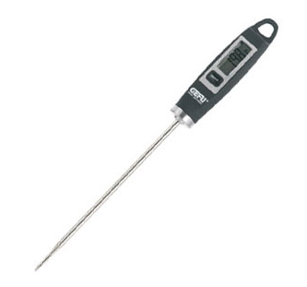
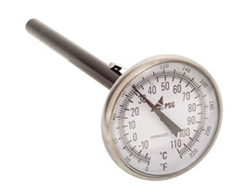
9190A Workload
Industrial RTDs/PRTs
Freezer probes
Thermocouples (common types: T, N, E & J)
Temperature transmitters
Digital thermometers
Dial thermometers
Food thermometers
Sanitary sensors
Mercury thermometers (less common)
Downhole thermometer

Slide 12
9190A Features
Reference sensor control (–P version only)
Setpoint temperature control can be passed from the internal sensor to an external reference PRT connected to the Reference Probe input
The 9190A controls the well temperature based on its measurement and position inside the well
This feature can minimize the effects of the axial gradient when the reference/control PRT is aligned with sensors that don’t reach the bottom of the well
Dual heater zone
Active heater zone control compensates for differential temperatures between zones
Minimizes axial temperature gradients

Slide 13
9190A Features
Ramp & Soak – allows user to define up to 8 setpoint temperatures and automatically ramp to and “soak” at each setpoint temperature.
No. Setpoints – select the number of setpoints (up to eight)
Soak Time – select the soak time duration in minutes after the well temperature settles within a user-specified Stability Limit
No. of Cycles – the number of cycles that the program is repeated
Direction – controls whether the setpoints are sequenced in one direction (ascending from 1 to 8) or in both directions (ascending from 1 to 8 and then descending from 8 to 1) before the sequence is repeated.
Soak
Ramp
Soak
Ramp

Slide 14
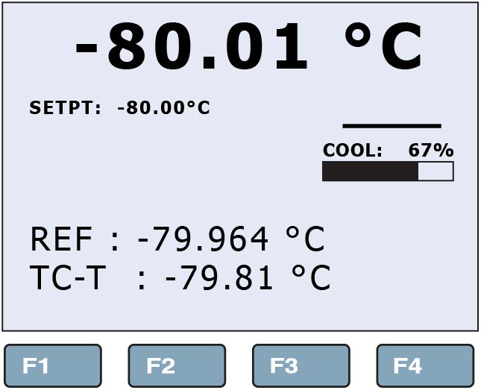
9190A Features
Stability indicator
Visually shows if the block temperature is stable and within the Stability Limits defined by the user
When the well temperature is NOT within the Stability Limits, the indicator shows as a wavy line
When the temperature is within the Stability Limits, the indicator shows as a flat line; indicating that a measurement can be made
Stability Indicator
Flat line indicates stable temperature within stability limits

Slide 15
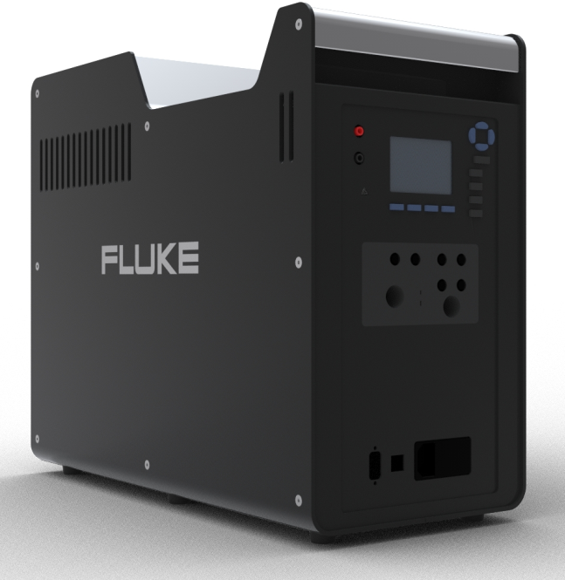
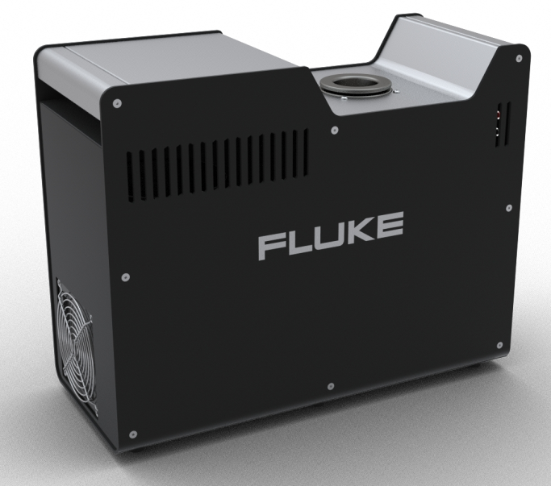
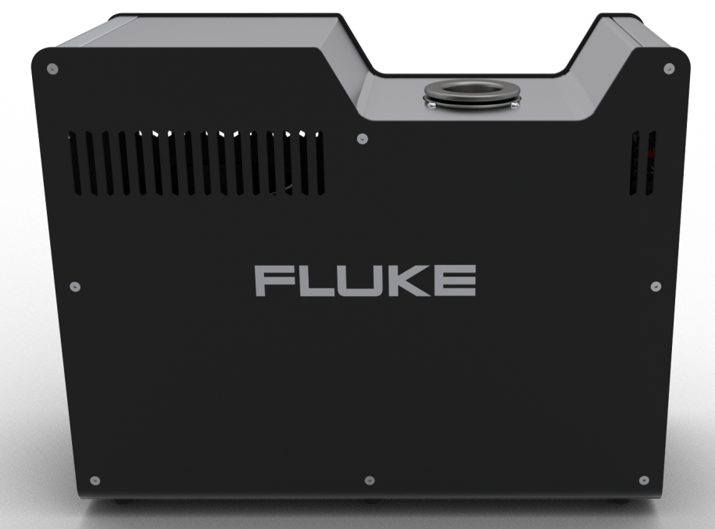
9190A Features
Security levels
The 9190A has two user-level access security levels (Low and High) to protect from undesired changes to the settings
Low – protects the specific metrological information and calibration information settings
High – Protects all operating parameters.
Ergonomics & industrial design
Two-handed carry
Built-in handles on front and back

Slide 16
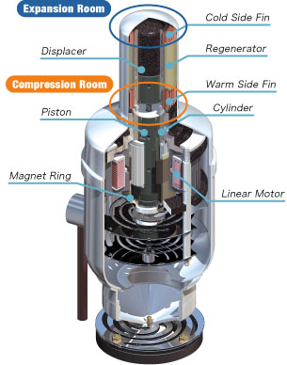
9190A Stirling Cooler
Free Piston Stirling Cooler
The piston is fixed to a magnet that is driven by a linear motor at a frequency of around 80Hz
The displacer is driven by the pressure differential, acting on the rod assembly, created by the piston motion and transmitted through the refrigerant to maintain the displacer at a constant phase angle to the piston
This piston action, repeatedly compresses and expands the refrigerant, and creates a warm (compression) and a cool (expansion) space. This is the Stirling Cycle.
The piston and the displacer are not connected mechanically and are free to move relative to each other
Stirling Cooler Section View
Notes:
The FPSC has two major moving parts (piston and displacer) that oscillate in a linear motion along the same axis within a single cylinder which is installed in a stainless steel casing.
The piston repeatedly compresses and expands the refrigerant gas to cool the tip (cold head) of the extended part of the casing.
By fixing a thermal load to the cold head, the FPSC can be used to cool an object down to ultra-cold temperatures.

Slide 17
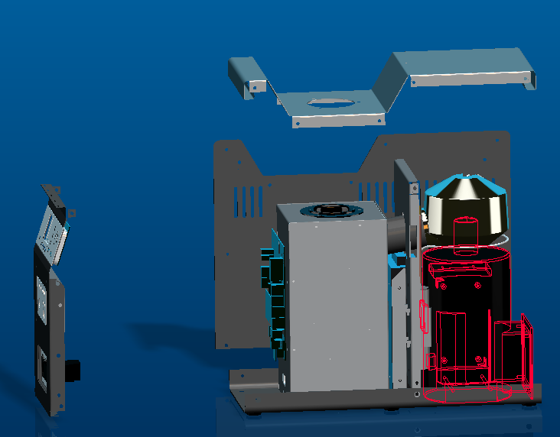
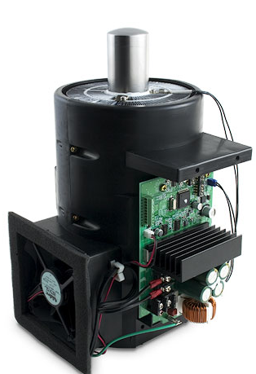
9190A Stirling Cooler
Insulated condenser
FPSC
Calibration Well
FPSC
FYI
Liquid refrigerant flows from the condenser to the well (requires gravity)
For this purpose, the condenser is positioned above the well
9190A must remain on a relatively flat, horizontal position to function properly

Slide 18

EURAMET cg-13
Conformance to EURAMET cg-13
Calibration of Temperature Block Calibrators
Gives guidance on measurement practices for the purpose of producing calibration results that can be recognized and accepted throughout Europe
The approaches taken are not mandatory
A means of promoting a consistent approach to good measurement practice
Key terminology:
Stability over time
Axial homogeneity
Radial homogeneity
Loading
Hysteresis
http://www.euramet.org
Notes:
Previously EA/10-13
Euramet/cg-13 does not specify values to which the drywell must perform, but describes the criteria that should be included in a mfr’s specifications
Describes good measurement practice for specifying drywell performance

Slide 19
EURAMET cg-13 – Stability
Notes:
Temperature instability is the deviation in temperature over time.
Temperature stability is one of the most basic and commonly measured limitations to performance of a dry-well. Measurements are often made over a period of 30 minutes.
Note that measurements are recorded digitally so that it can be plotted and analyzed.
Define example of 2 sigma (95% confidence level) and peak stability measurements.
A dry-well should be characterized over the range of use. Typically a high, medium and low temperatures are selected as representative.

Slide 20
EURAMET cg-13 – Axial Uniformity
Axial Uniformity – Variation in the temperature along the axial length of the insert (block) within the measurement zone.
Notes:
Temperature measurements are made incrementally along the measurement zone with a special gradient measuring thermometer. The sensor is recommended to be less than 5 mm long and the sheath to 6 mm or less in diameter. It must have low stem conduction. PRTs are preferred but noble metal TCs can be used. All TCs can have alloy homogeneity problems
A reference thermometer is maintained at the bottom of 1 well. It will help improve data by eliminating instability and disturbances from moving the gradient probe.
The gradient thermometer makes reading at incremental distances along the length of the measurement zone.
The normalized difference between the gradient and reference temperatures can be used to plot the temperature gradient.

Slide 21
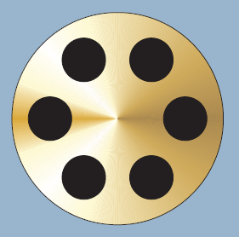
EURAMET cg-13 – Radial Uniformity
Radial Uniformity – Variation in the temperature between different wells of the insert (block) within the measurement zone.
Reference
probe
Gradient
probe
Notes:
Radial temperature measurement is made between wells in a block or sleeve at the bottom of wells.
All the wells must be of the same size so that the measurement thermometers have a proper fit.
Two thermometers of the same type and sensor length are used. Close calibrations between them are helpful.
One thermometer acts as the reference. The other is moved from well to well and all measurements are compared to the reference thermometer.
Measurements may be made at the high, medium and low points in the range and the results interpolated for in between temperatures.

Slide 22
EURAMET cg-13 – Thermal Loading
Thermal Loading
Additional heat loss due to increased numbers or size of thermometers
Creates a shift in the temperature gradient in the sleeve (block) of the drywell
The Temperature Controller cannot completely compensate for this shift
The result can be a temperature error that is particularly apparent in the Direct Mode (i.e. no reference thermometer)

Slide 23
EURAMET cg-13 – Thermal Loading
Measurement - Direct Mode
Notes:
Block loading is measured with a multi-channel readout. Several “dummy” thermometers are used to simulate heat losses from various wells. They should be appropriately sized for the wells.
Insert the first live thermometer and allow the dry-well to stabilize for a time while recording the data. This establishes the equivalent to the “Display Temperature”.
Insert the second live thermometer and continue to record until it is again stabilized.
Insert “Dummy” thermometers in the same manner until all of the available wells are full (or until a typical batch level measurement amount is made).
Reverse the process by pulling one out at time. Continue to record during the entire process.
The reversing of the process helps to establish repeatability.
Determine the effect of loading per various conditions.

Slide 24
EURAMET cg-13 – Hysteresis
Notes:
Hysteresis of the control sensor is the result of varying strain on a sensing element as it moves through a range of temperature and the effect if its immediate thermal history.
As the dry-well cycles between the maximum and minimum set point temperatures the actual measured temperature (as measured by an external reference) will vary. Typical resistances of an industrial PRT (IPRT) are low when heating and high when cooling.
When the IPRT is installed in a dry-well as a temperature control sensor, the sense is reversed by the controller and the set-point temperature will be higher when heating and lower when cooling.
Measure by recording multiple cycles with a good hysteresis free monitor thermometer over the desired range.
The effect is typically largest at the midpoint of the range.
The hysteresis is reasonably repeatable.

Slide 25
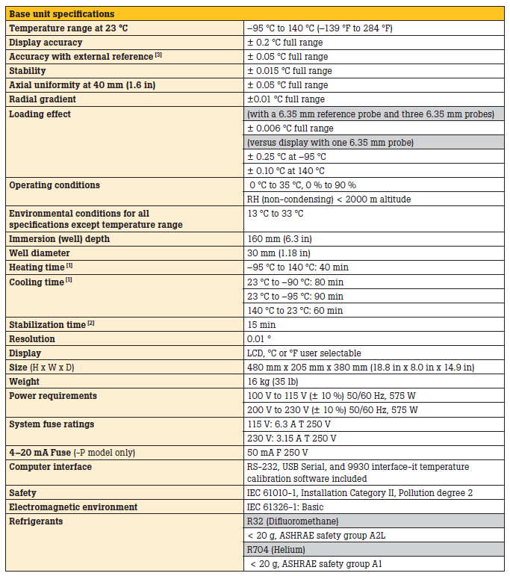
9190A Base Unit Specifications

Slide 26
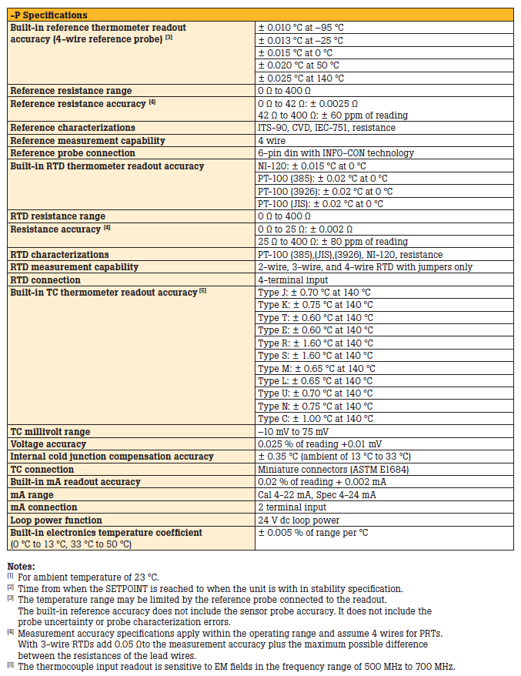
9190A Optional Process Electronics Specs

Slide 27
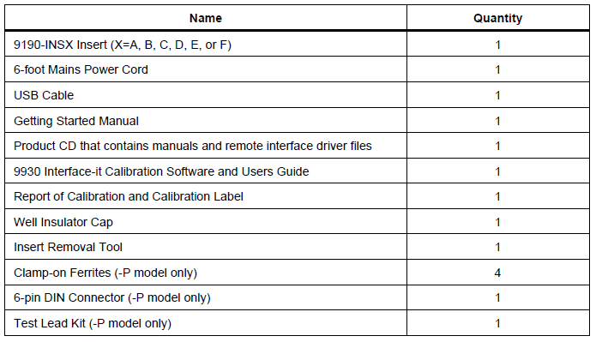
9190A Standard Equipment
Included in the box

Slide 28
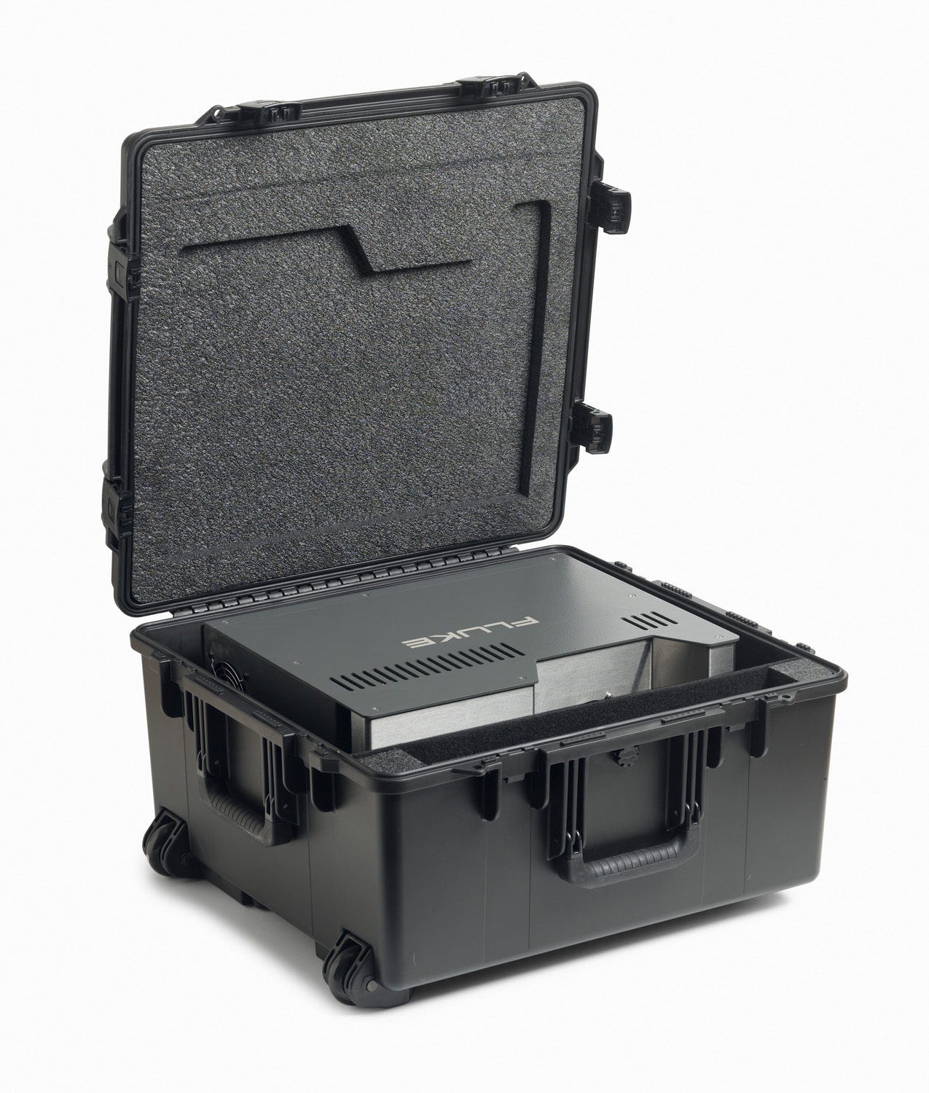
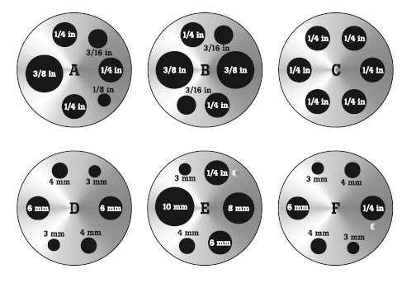
9190A Optional Equipment
Item Model | Description
9190A-CASE | 9190A Carrying Case
9190-INSA | 9190A Insert A, imperial miscellaneous holes
9190-INSB | 9190A Insert B, imperial comparison holes
9190-INSC | 9190A Insert C, 0.25 inch holes
9190-INSD | 9190A Insert D, metric comparison holes
9190-INSE | 9190A Insert E, metric miscellaneous holes with 0.25 inch hole
9190-INSF | 9190A Insert F, metric comparison miscellaneous holes with 0.25 inch hole
9190-INSY1 | 9190A Insert Y, custom insert with blank insulator
9190-INSY2 | 9190A Insert Y, custom insert with custom insulator
9190-INSZ | 9190A Insert Z, blank insert
9190A Case
9190A Inserts

Slide 29
Sales and Marketing Materials
9190A Launch Page
http://eu.flukecal.com/9190A-Launch-EU
Collateral
Brochure
Data sheet
Press Release
E-advertising
Email blast
Web banner
Product web page
Print advertising
Full/half/quarter page ads
Trade shows
Quickscreen
Sales tools
Sales guide
Sales training presentation
Customer presentation
Catalog copy
Product photos

Slide 30
Questions
???

